Slide 1
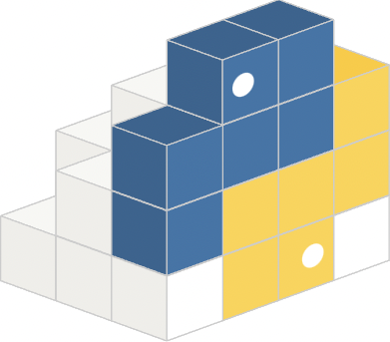



A Comparison Between Model-Less And Model-Based RL Approaches
COVER SLIDE
Intro To Artificial Intelligence
- Final Project
To explore Model-Free RL through a mathematical approach to playing tennis and also to explore Model-Based RL through playing tennis using the Deep Q Network and compare them.
A Project By: -
Rajdeep Bhattacharya
Adesh Agarwal
| Pranay Udayagiri
| Rajwinder Singh

Slide 2
The Project In A Nutshell
In Brief:
In the Final Project we worked on a comparison between Model-Free Reinforcement Learning and Model-Based Reinforcement Learning.
In this project we are comparing Model-Free vs Model-Based reinforcement learning processes through an online game of tennis. To explore Model-Free RL, we are using a mathematical approach to playing tennis. And for the Model-Based RL we are using Tennis game played through the Deep Q Network.
We have used NumPy, PyGame, Keras and Tensor Flow Libraries.
1

Slide 3
A short list of project objectives using bullet points.
Statement Of Project Objectives
Project Objectives:
We made the Tennis environment to analyze both Model-Free and Model-Based RL system.
We play the game using model-free and model-based algorithms, then we observe and analyze the outcomes.
We talk about the presence of policy and the absence of policy, variance, performance, time taken for learning, trainability, scalability, bias, sample efficiency, etc. to compare the two approaches.
2

Slide 4
A Short Glimpse Into Our Project.
Our Approach
The Approach:
The project will be implemented using Python. Please use the latest version of Python for optimum running of the codes.
Alongside the Tennis Environment (which uses Deep Q Network) we have also used NumPy, PyGame, Keras and Tensor Flow Libraries.
The reinforcement technique that will be used to train the agent is Q Learning.
The model used in the Model-Based Learning is DQN.

Slide 5
Deliverables.
Deliverables Slide
₀₁
₀₂
₀₃
The Project Proposal (.ppt file).
The Code.
The User
Documentation
Manual
(.md file).
₀₄
₀₅
₀₆
The Demo Video YouTube Link.
The Demo Video Presentation
(.ppt file).
Comparison And Evaluation
(.pdf file).

Slide 6
Evaluation.
Evaluation Methodology Slide
The details of the evaluation can be found in Comparison And Evaluation file.

Slide 7
Thank you.
End Slide

